Slide 1

POE-Injector
Parman company
Mentor : Mrs. Shaterzade
Members : Mehrad Afshari Nazari, Arezoo Savlani

Slide 2

TABLE Of CONTENTS
01 02 03
Introduction
Theory & Initial information
Schematic Design
04
PCB Design
05
Agile Working

Slide 3

01
Introduction

Slide 4

Project Overview and Objectives :
Project Description:
This project involves the design of a plug-in electronic board that performs control and management functions for a main PoE injector board. The plug-in board includes a microcontroller responsible for generating and managing I2C signals to interact with and control the PoE controller chip on the main board , UART signals to communicating with a debugging and monitoring system and RMII signals for communicating with physical layer of network. The primary objective is to enhance the operational capabilities and streamline the control processes of the PoE injector system.
Goals and Objectives:
Develop a plug-in board capable of efficiently managing the PoE injector main board's operations.
Create a modular plug-in board that can be easily attached or detached from the main PoE injector board.
:

Slide 5

02
Theory & Initial information

Slide 6
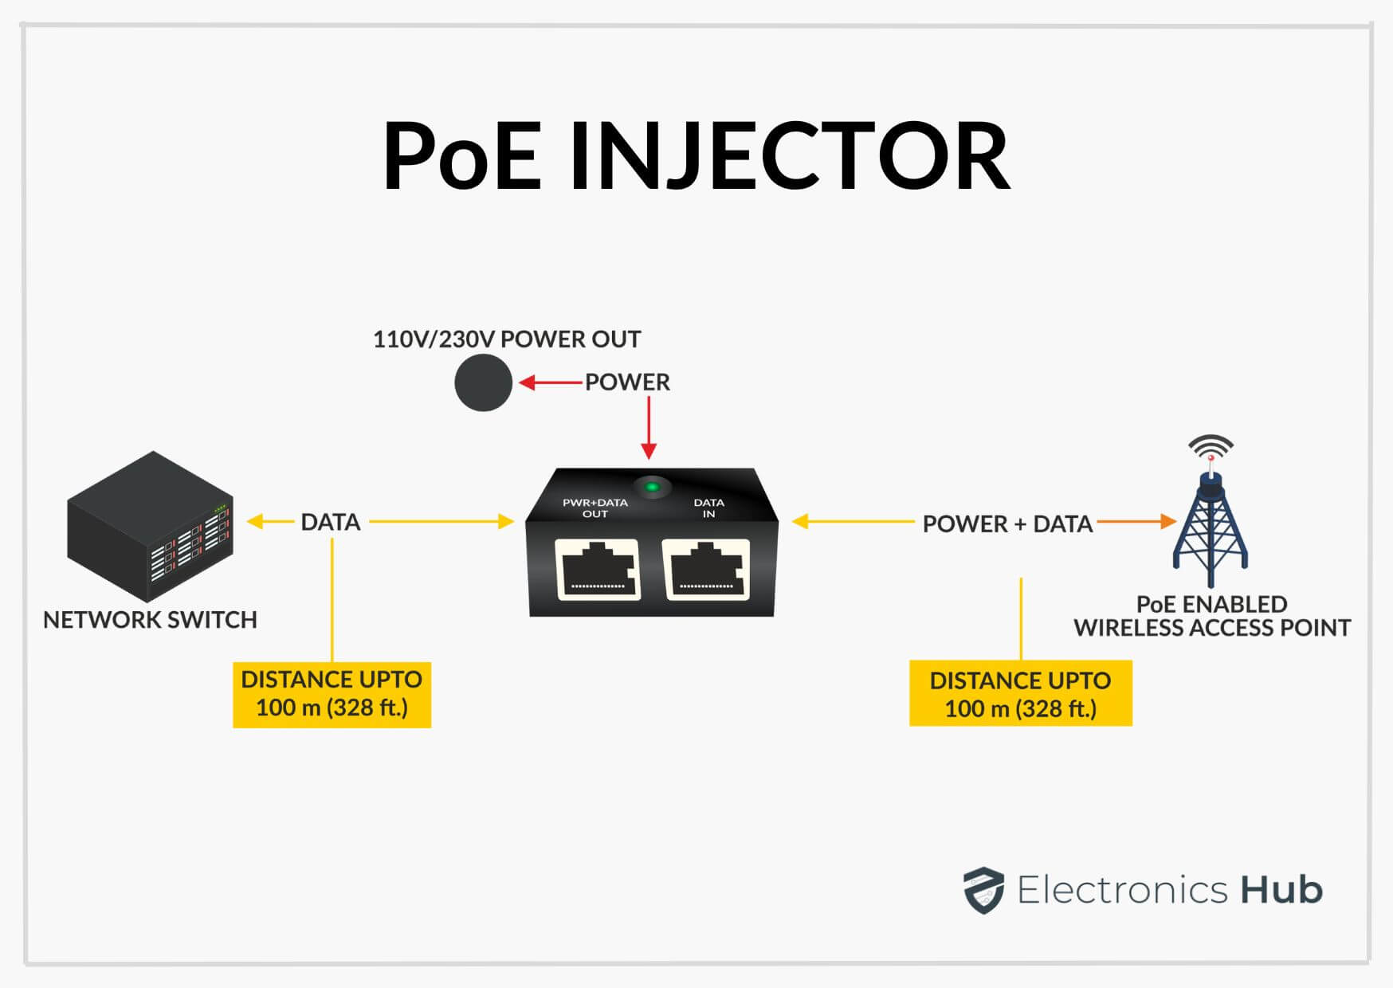
PoE injector:
A PoE injector (Power over Ethernet injector) is a device used to supply both data and electrical power to network devices through a single Ethernet cable. It allows devices like IP cameras, wireless access points, and VoIP phones, which require both data and power, to be connected to a network without needing separate power adapters.
:

Slide 7
Benefits:
Simplified installation
Single cable for data and power
No need for nearby power outlets
Flexible device placement
Reduced cable clutter
Cost-effective power solution
Easy network expansion
Supports remote devices (IP cameras, access points)
Safe and reliable power distribution
PoE standards compatibility (802.3af, 802.3at, 802.3bt)

Slide 8
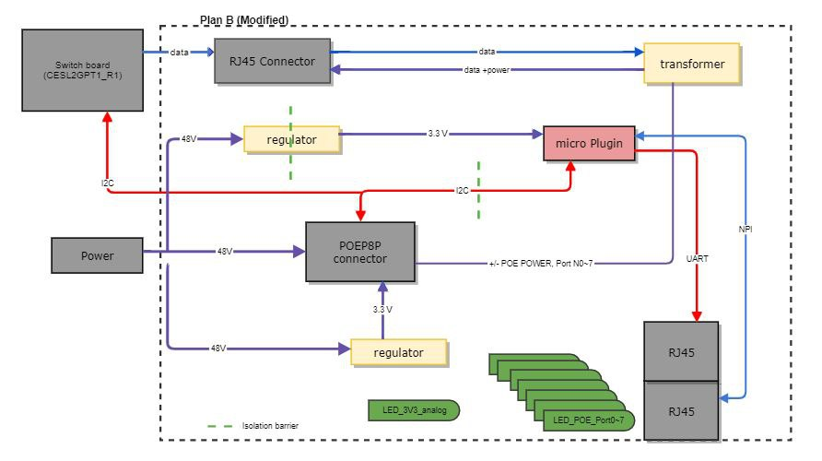
Block Diagram of main board

Slide 9
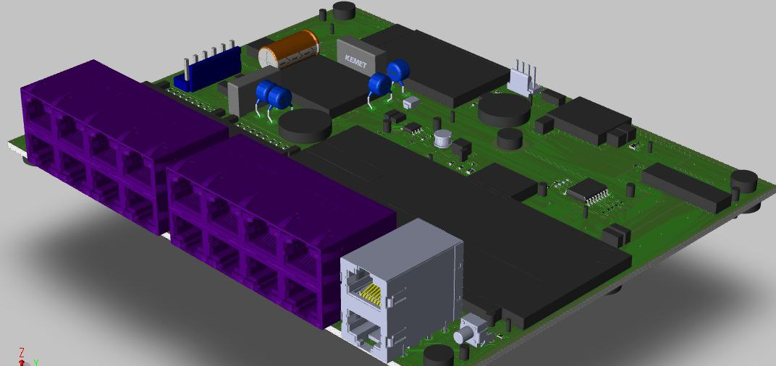
3D model of PCB Board
:

Slide 10
Keyword of contents:
Protocols : I2C,UART,RMII
Network models: OSI , TCP/IP
Cat5 cables , PoE Devices , PoE standards
NPI framework
UART communication standards : RS-232
debugging and programming interfaces : JTAG and SWD
Transformer and isolator ICs
eeprom
ferrite bead
fiducial
:

Slide 11

03
Schematic Design

Slide 12
Steps of schematic design:
01 02 03
Creating Block Diagram
Choosing ICs based on needs and being available
Preparing library of components
04
Creating pages and placing components in related pages
05
Organizing and arranging pages by standard numbering
06
Making connections between components with wires, labels, global nets ,bus and offpage connectors

Slide 13
Steps of schematic design:
08
07
Adding essential components such as resistors, capacitors, ferrite beads based on application notes and electronic considerations
Creating netlist to finding out :
Different nets with similar name and vice versa
09
10
11
Creating DRS report to finding out :
Unconnected pins
Not allowed connections based on direction
…
Annotating number of components
Creating layout and sync with schematic

Slide 14
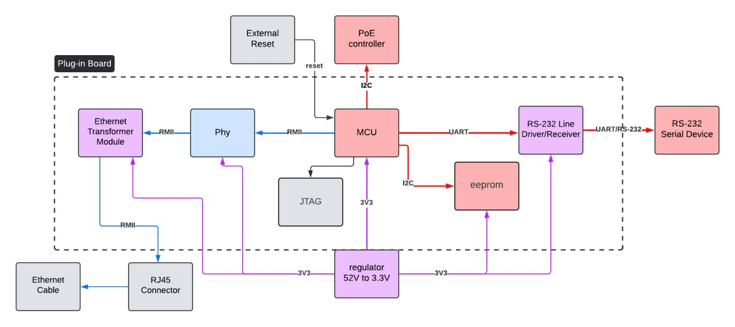
Block Diagram of plug-in board

Slide 15
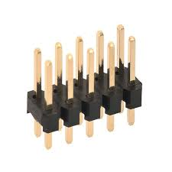
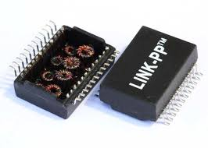
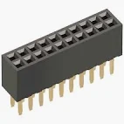
ICs
MCU:
STM32F765
AT24C04D_SSHM_T(eeprom)
JTAG
Communication Path: MAX3232EIPW Driver
Port: 2x10 Pin Male/Female Header
Ethernet Path
DP83848KSQ_NOPB
LP82453NL Transformer

Slide 16
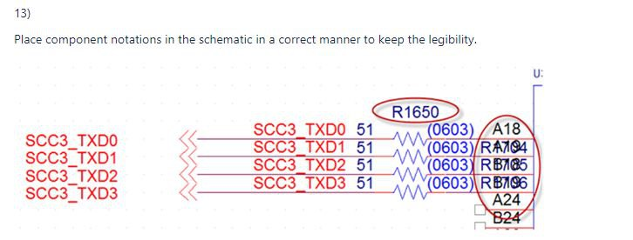
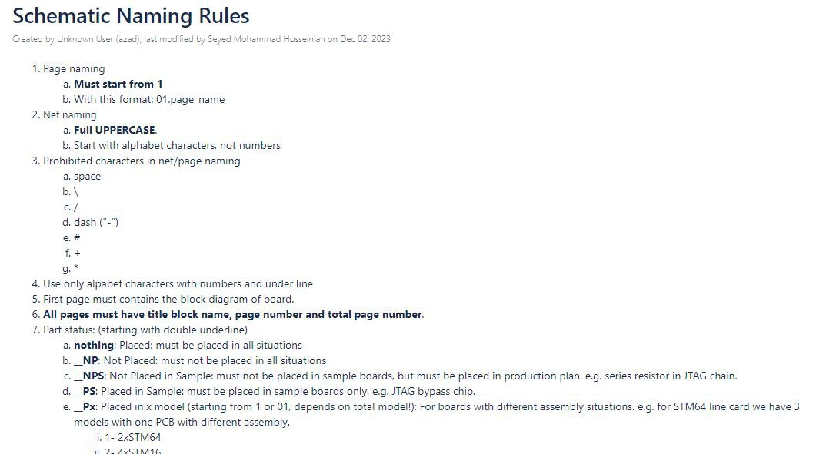
Standards
Try as much as you can to not use specific letter (/ or + or (Use underline instead of space)
Put numbers for your pages and parts.
Try not to use global nets with same voltage and different names.
Elements names(Page number + number or letter like R313: resistor 13 of page 3)
Name your design file with date of edit. (Like: POEICPT1_R1_2024_8_13_3)
:

Slide 17
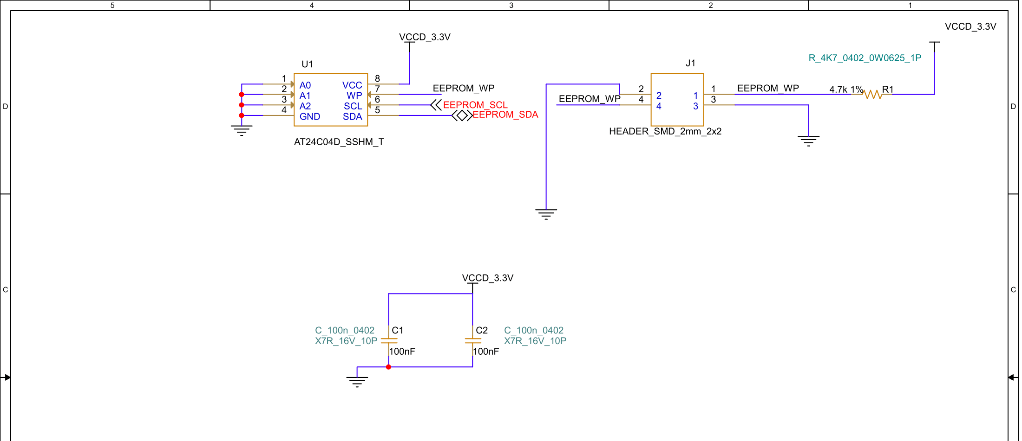
Final Design:
eeprom
:

Slide 18
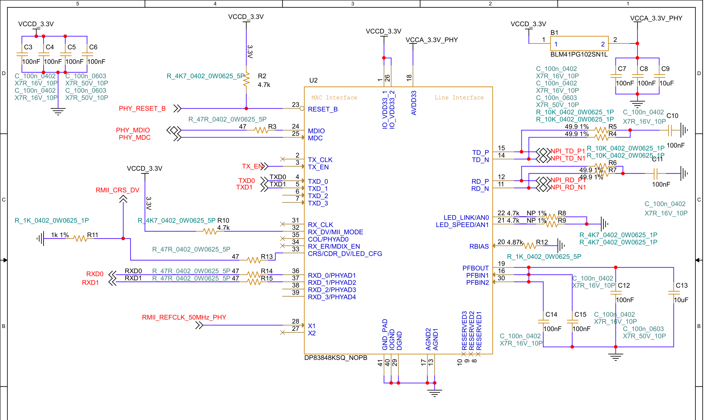
Final Design:
phy
:

Slide 19
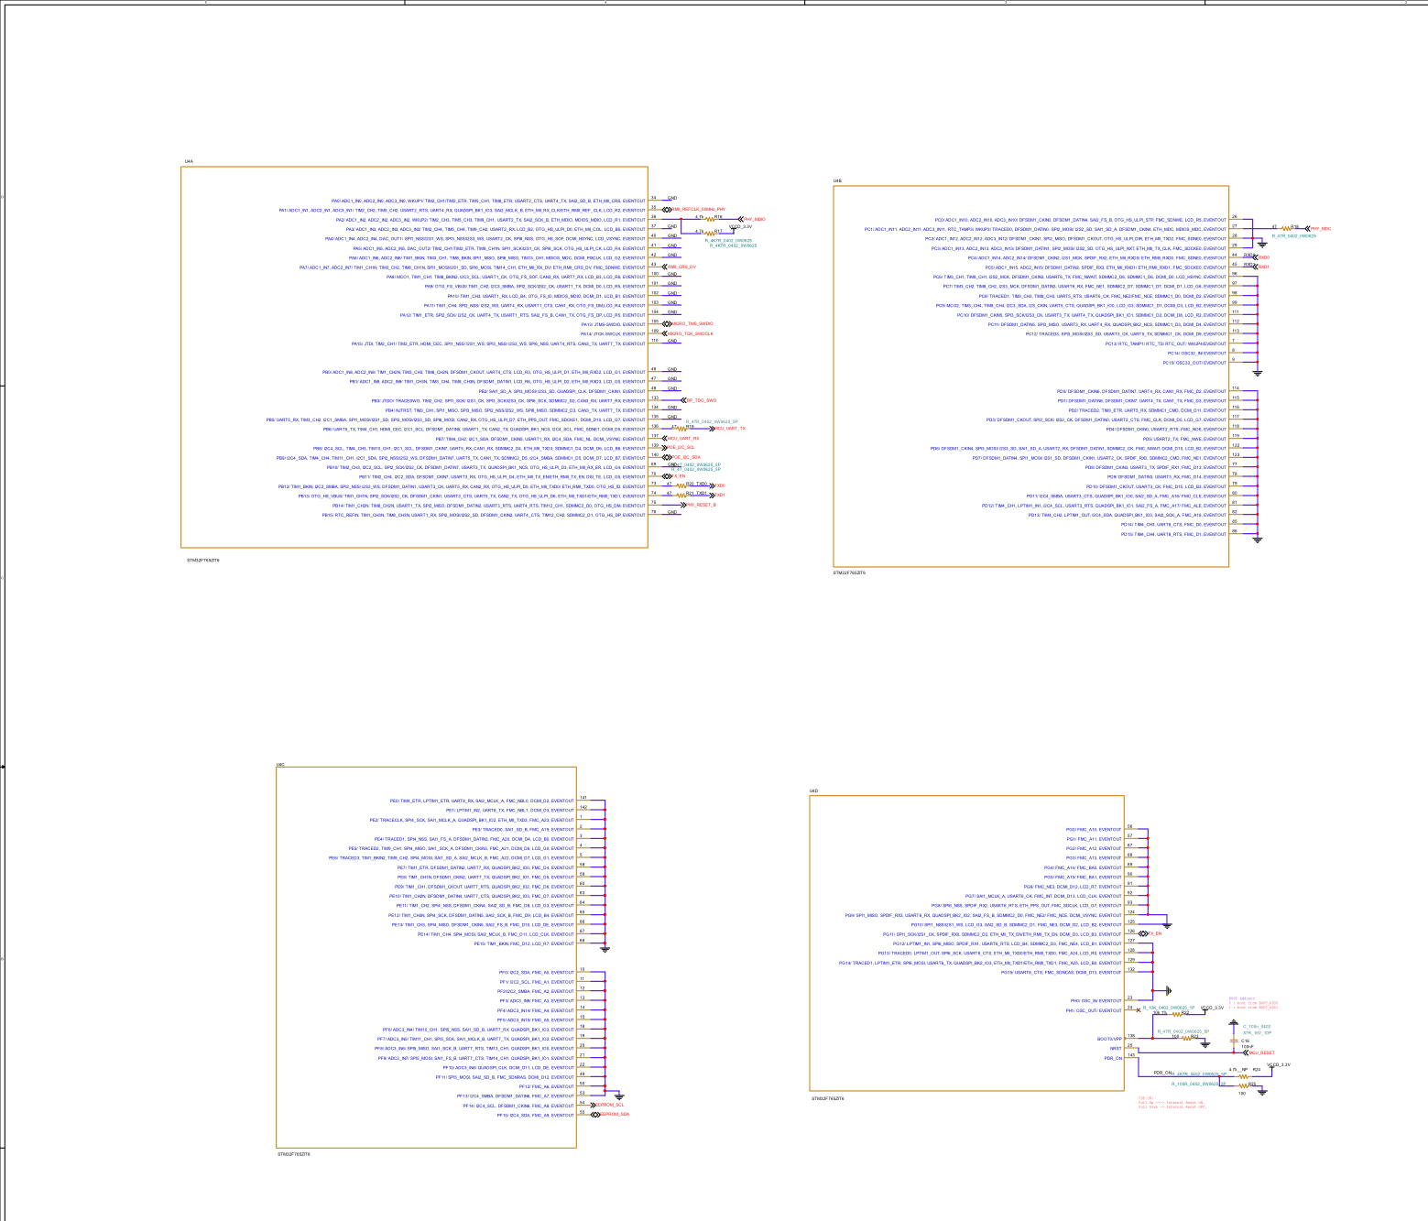
Final Design:
MCU
:

Slide 20
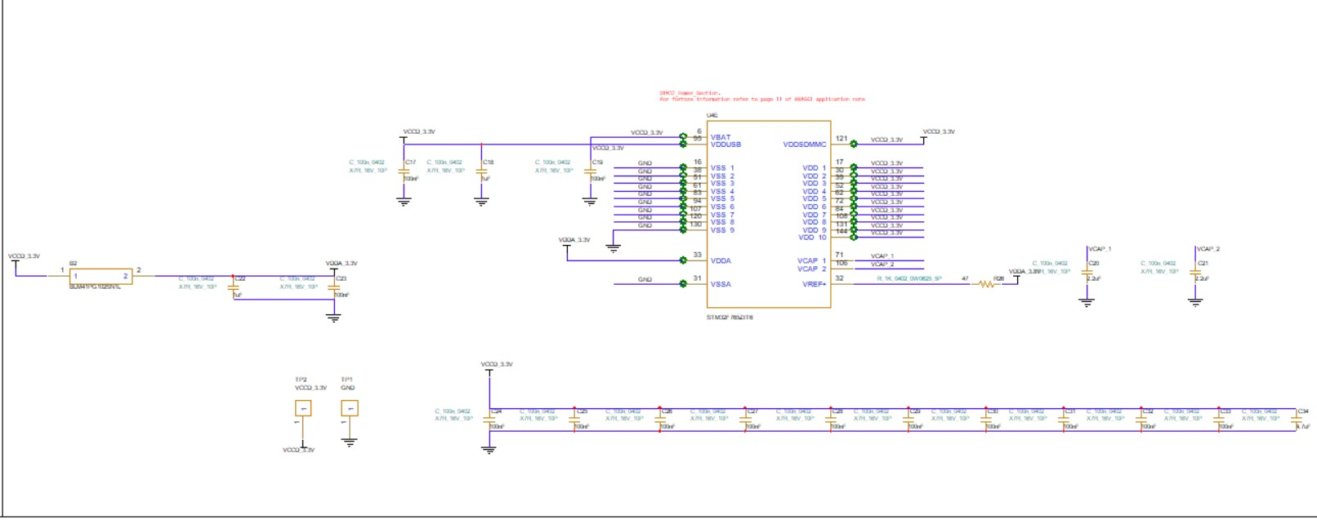
Final Design:
MCU_POWER
:

Slide 21
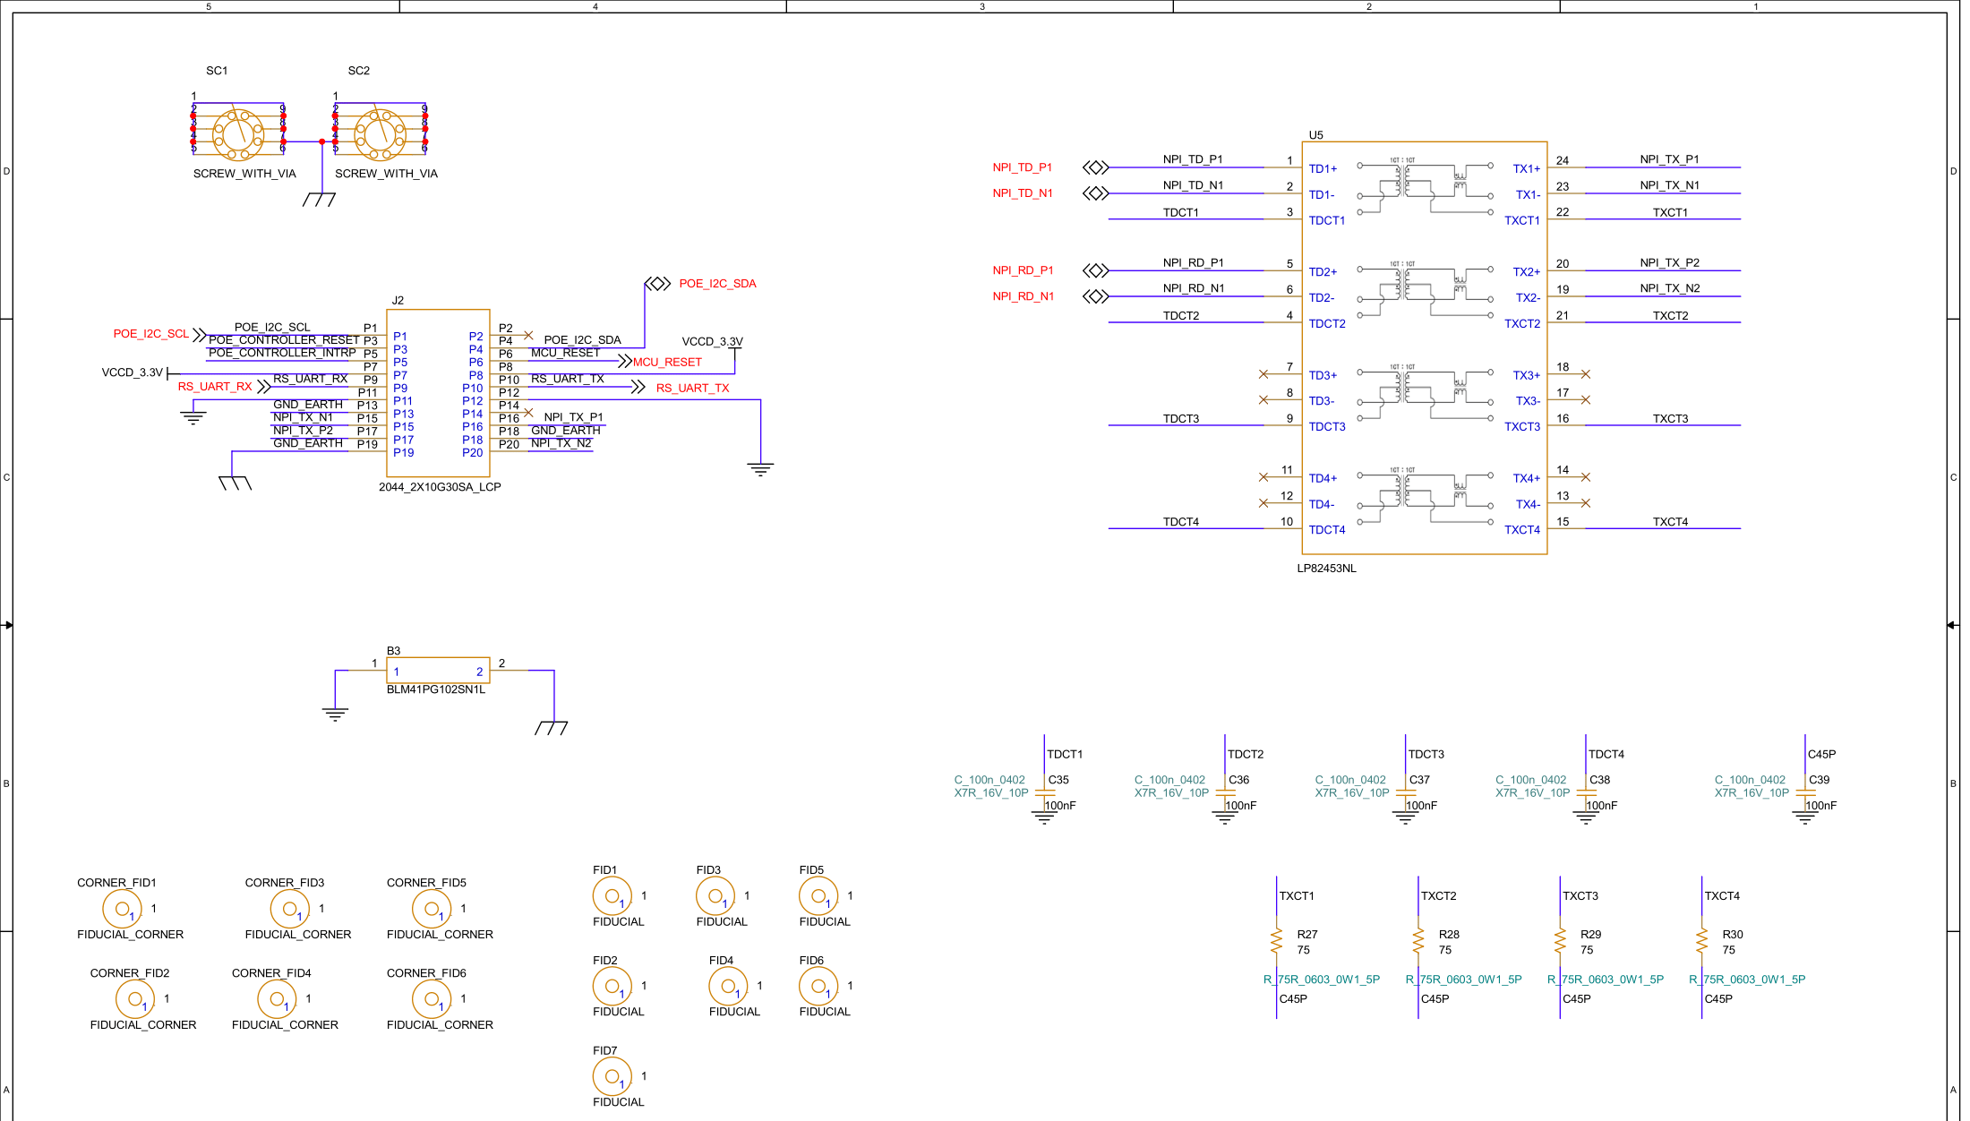
Final Design:
port
:

Slide 22
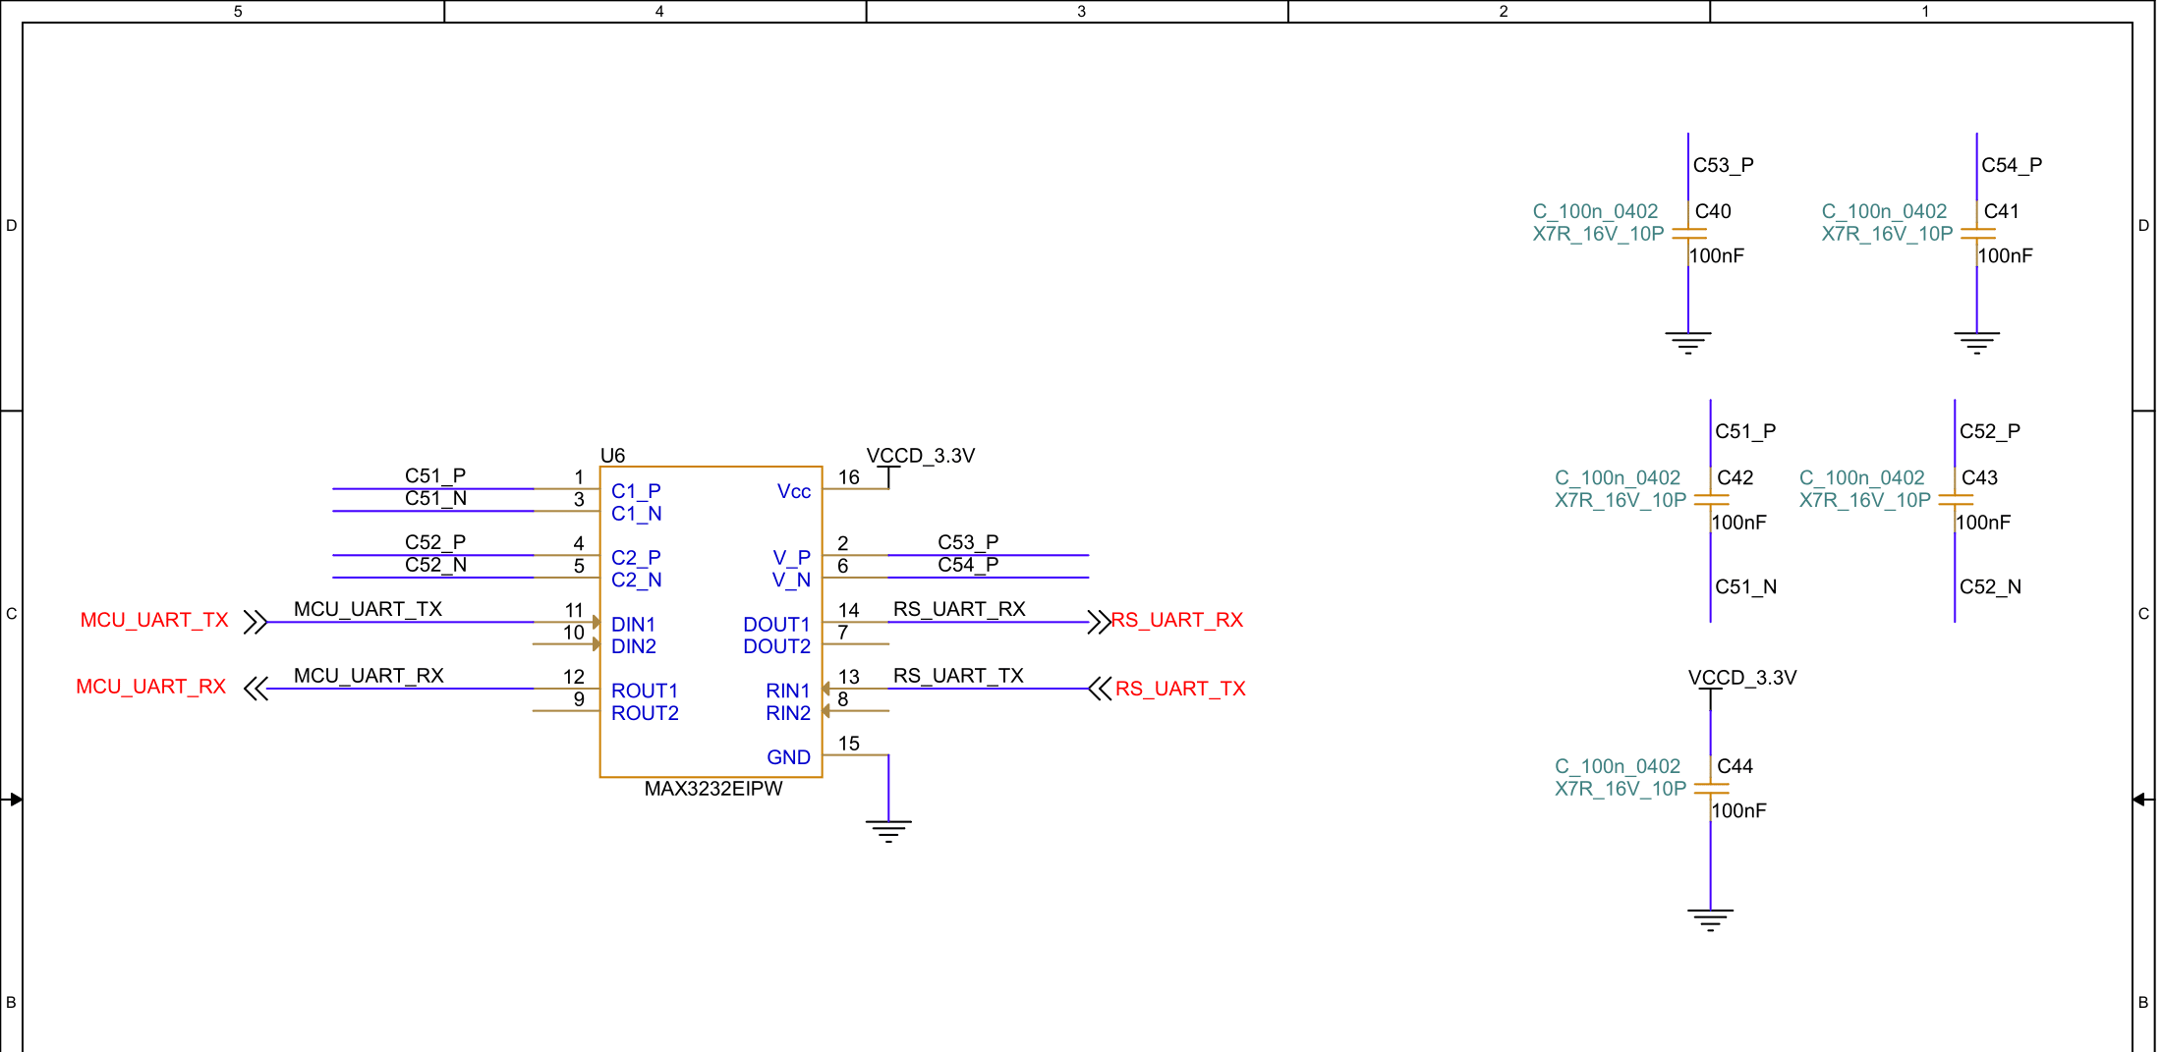
Final Design:
RS-232 Driver/receiver
:

Slide 23
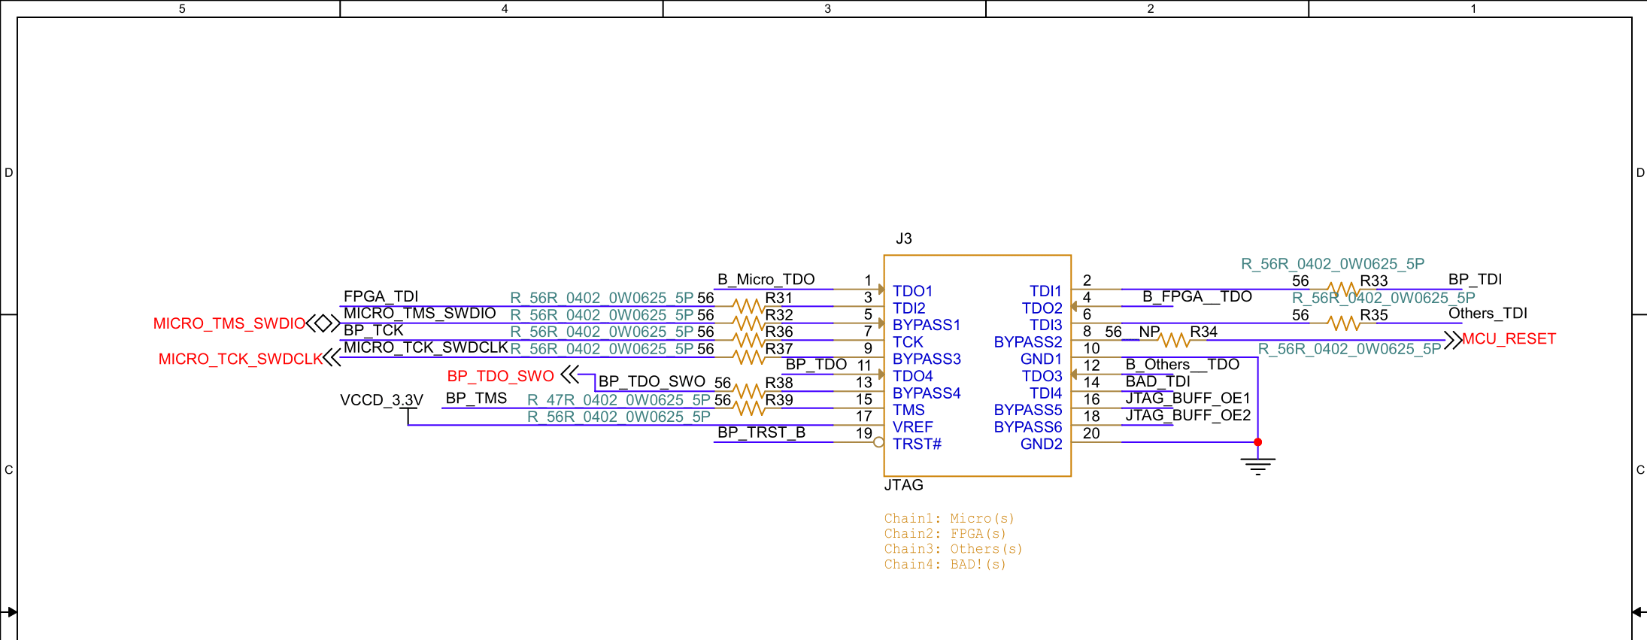
Final Design:
JTAG
:

Slide 24
04
PCB Design

Slide 25
Steps of PCB design:
01 02 03
outline
Drawing outline and keepin shape based on determined dimensions and standard clearance edge
library Preparing footprint libraries and setting layer stack-up
placement Placing components based on standard distances and determined places for screws and ports
04
plane
Creating plane for voltage supplies
05
Match impedance
Calculating wire impedances with Polar and finding appropriate wire width
06
constraints
Creating net groups and adjusting their constraints

Slide 26

Steps of PCB design:
07
Routing
Connecting pins and applying fanout when changing layers
08
DRC
Setting rules and fixing DRC errors.
09
Waive unnecessary DRCs
10
simulation

Slide 27
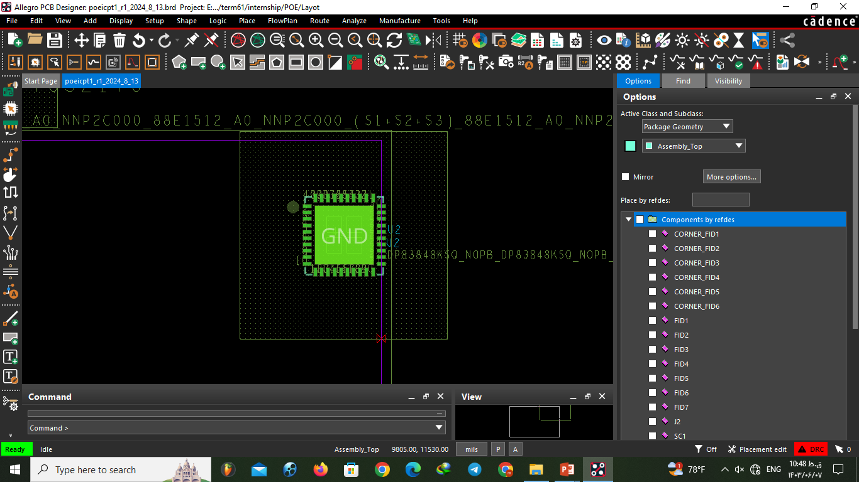
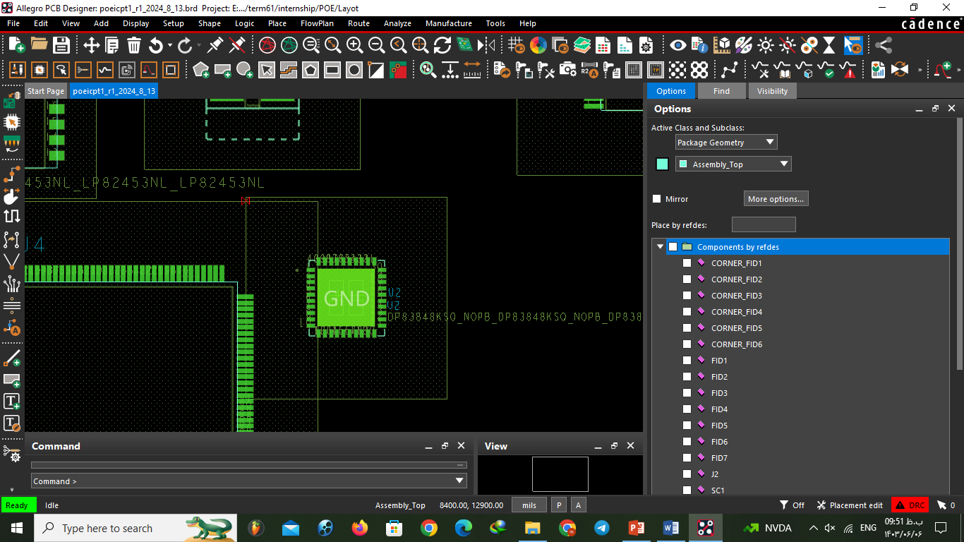
Standards of placement
- DISTANCE:
Between resistors : 20MILS
Between resistors and IC: 100 MILS
Between two SMD IC: 150 MILS
Between IC and Through whole: 200 MILS
Corner fiducials distance from outline corners : 3 mm
:

Slide 28
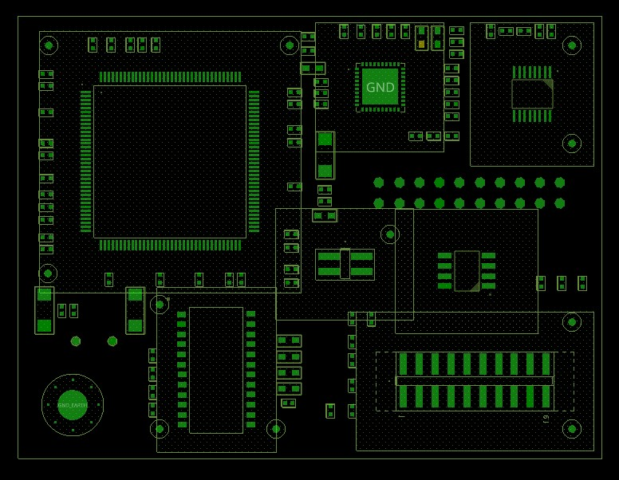
Example of placement
:

Slide 29
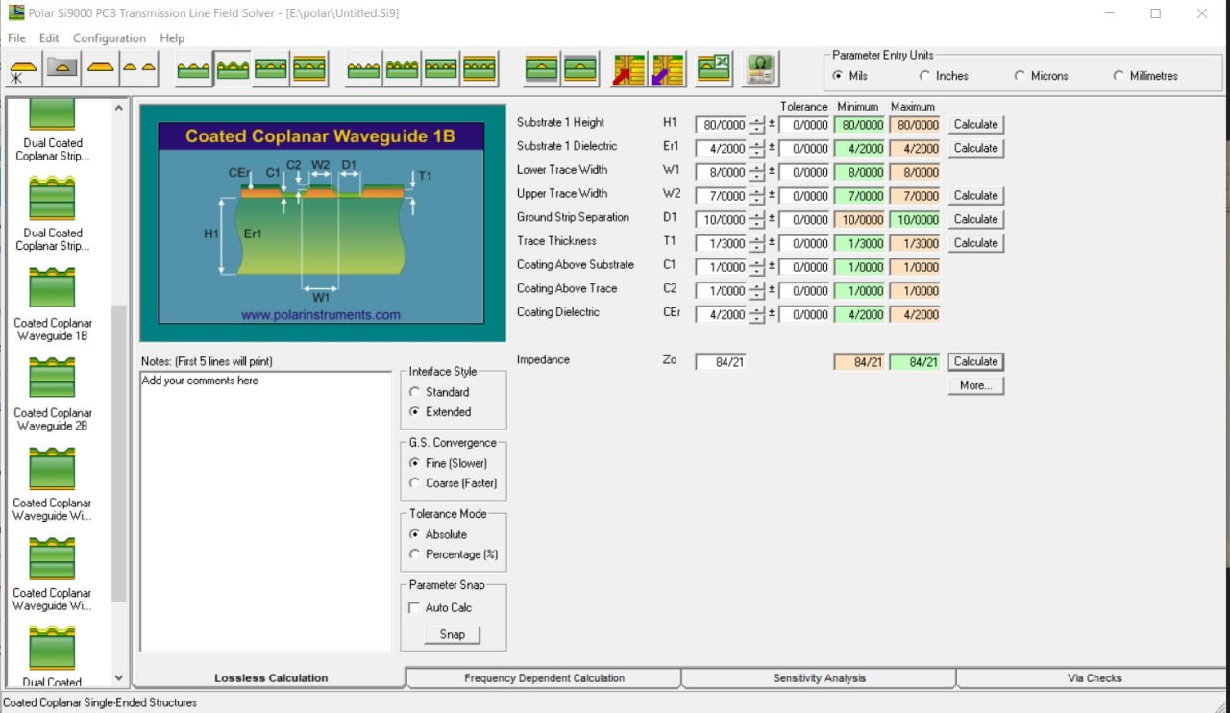
Calculating wire impedance with Polar
:

Slide 30
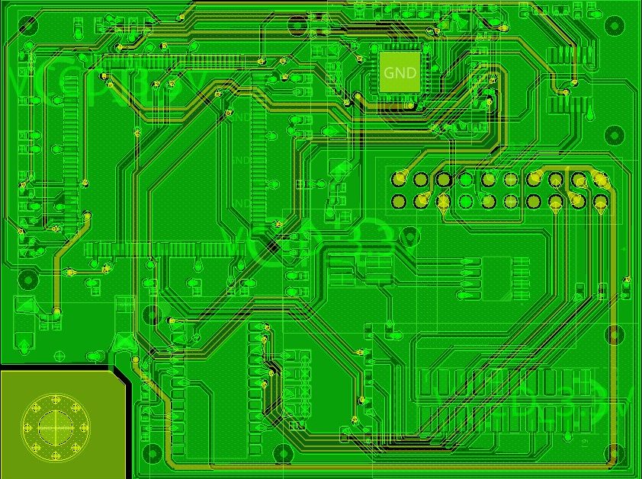
Final PCB Design - Savlani
:

Slide 31
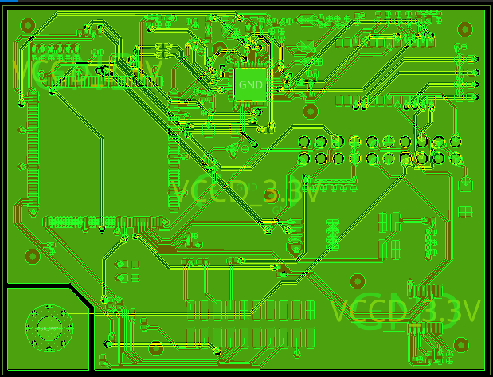
Final PCB Design - Afshari
:

Slide 32
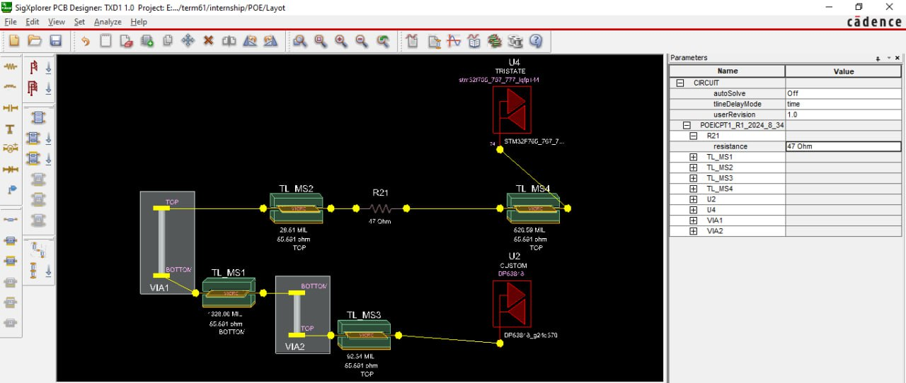
Example of simulation:
:

Slide 33
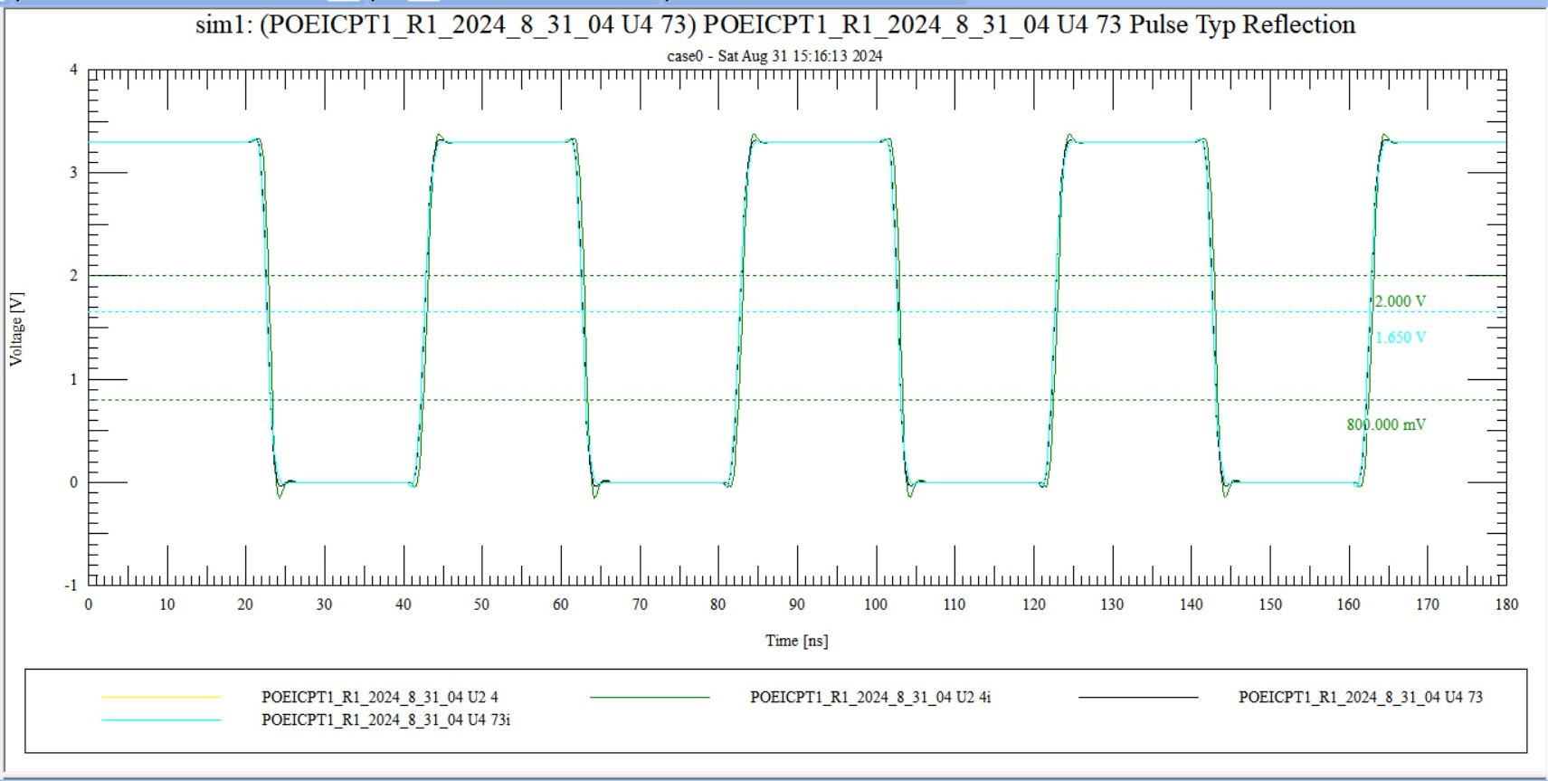
Example of simulation:
47ohm source destination resistor after assigning pin module
:

Slide 34
05
Agile Working

Slide 35

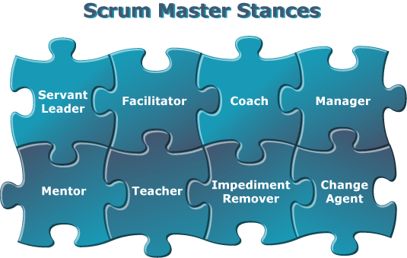
Scrum master
Scrum Master: The Scrum Master is a key role within a Scrum team, serving as a facilitator and coach. They are responsible for ensuring that Scrum practices are properly implemented and followed. The Scrum Master helps the team by removing obstacles that may hinder progress, fostering an environment of collaboration and continuous improvement, and coaching team members on Scrum principles and practices. Their goal is to enhance the team's effectiveness and efficiency in delivering high-quality results.

Slide 36
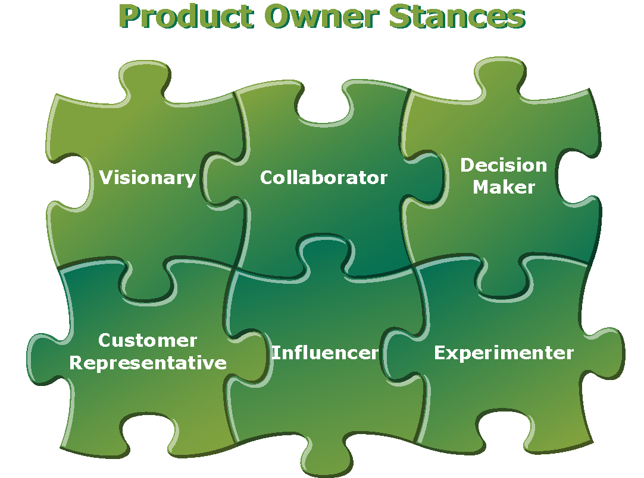
Product owner
Product Owner: The Product Owner is responsible for defining and managing the product backlog, which is a prioritized list of features, enhancements, and fixes for the product. They act as a liaison between the stakeholders (such as customers, users, and business leaders) and the Scrum team, ensuring that the team is working on the most valuable tasks. The Product Owner clarifies requirements, sets priorities, and makes decisions about what to build and when, aiming to maximize the product's value and meet stakeholder expectations.

Slide 37
Example Kanon table:
Week1(Sprint 1&2) | To Do | Doing | Test and debug | Done
Savlani | -Instal cadence -Search about PoE -Finish proposals | -Installing cadence -Search about PoE -Writing proposals | Problem in zip file - - | No Yes Yes
Afshari | -Instal cadence -Search about PoE | -Clearing storage -Search about PoE | Problem in zip file - | No Yes
Mrs.Shaterzadeh | - Send educational content for cadence | - | - | Yes
:

Slide 38

Thanks!

